Slide 1

E-Commerce Analysis Report

Slide 2

AGENDA
Objective
Business Questions
Tech works
VISUAL AIDS
FINAL TIPS & Recommendations

Slide 3

Objective

Slide 4

Analyze sales and its trends through some factors as discounts, delivery performance, returns, and customer behavior and find solutions to increase and improve it.
Main objective

Slide 5

Business questions
Why do customers return products by category?
Why are 50% of orders delayed?
What is the monthly sales percentage?
What is the annual sales percentage?
What is the percentage of purchases by age group?
What are the characteristics of each company in terms of sales, discounts, and prices?

Slide 6

Tech works
Tools and Techniques:
1) Tools: Server, Power BI, Python (Pandas, Matplotlib, Seaborn, sqlalchemy, Faker, Statsmodels).
2) Techniques: Used web scrapping to get data and used faker library to generate some data based on data which scrapped then used sql server to build database and data warehouse by using python, then used power bi to analyze data, then used python to test hypothesis for Making the final decision.

Slide 7
VISUAL AIDS
Important visuals for our analysis

Slide 8
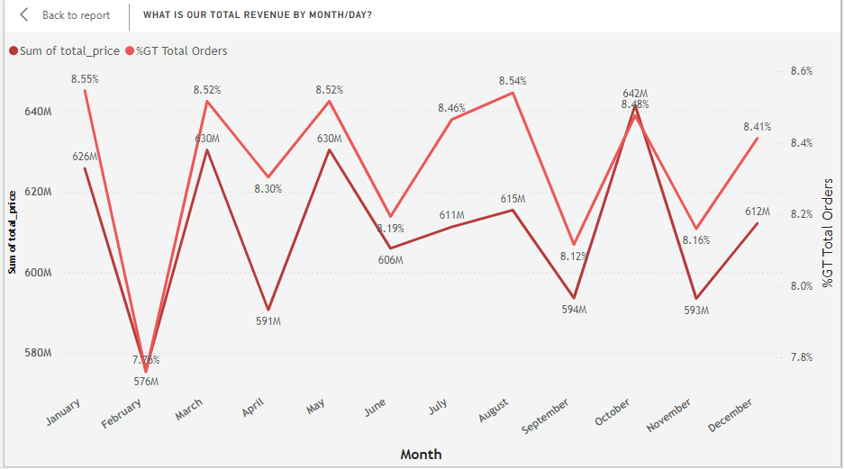
What is our Total revenue by time?

Slide 9
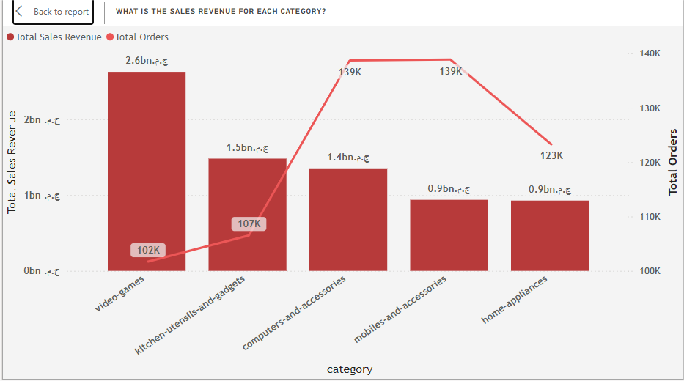
What is The sales revenue for each categoty?

Slide 10
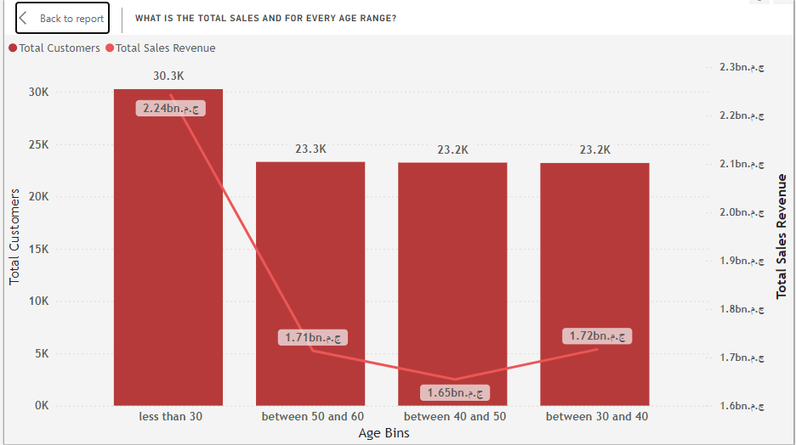
What is The total sales for every age range?

Slide 11
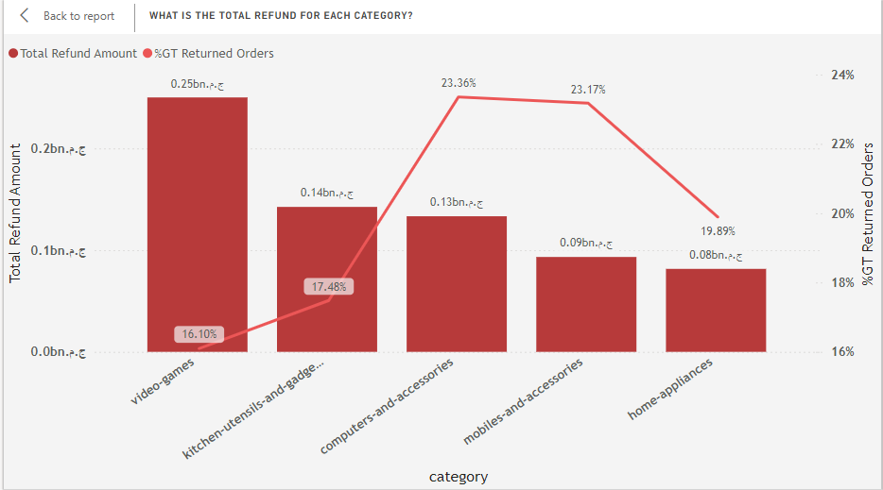
What is The total refund for each category?

Slide 12
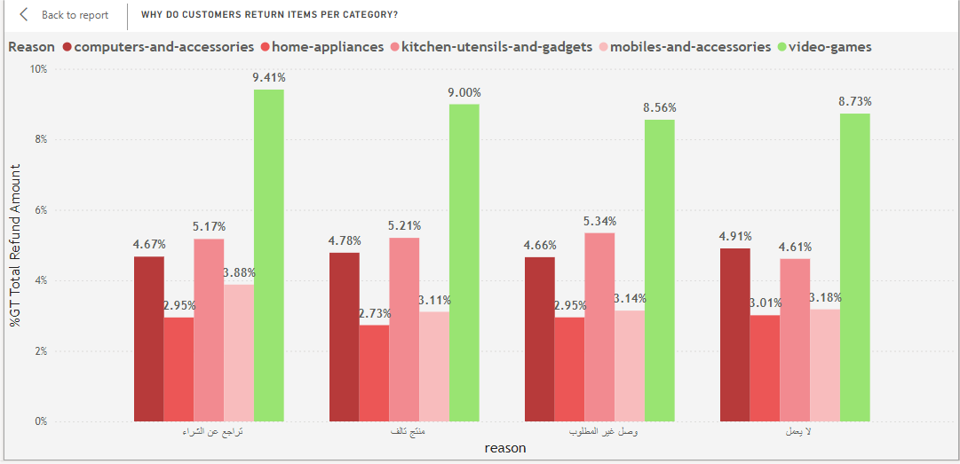
Why customers return orders for each category?

Slide 13
Important measures
METRIC | MEASUREMENT | TARGET | ACTUAL
AVG orders per customer | # of orders | 5 | 2.33
Total Revenue | EGP Pound | 11bn | 7.33bn
Total Refund | EGP Pound | >50m | 1.08bn
Delayed Shipments | Percentage (%) | 10% | 50.12%
Return Rate | Percentage (%) | 5% | 35.94%

Slide 14
FINAL TIPS & Recommendations
Adjust discounts and offers, especially for video game products, and test the product's functionality before shipping whenever possible.
Increasing staff to handle a larger volume of orders, expedite order processing, and liaise with shipping companies to accelerate shipping.
Increasing promotions in February and September to boost sales.
Adjusting some discounts on certain products and increasing promotions.
Launching advertising campaigns and special offers to attract customers aged 30 to 50 and trying to maintain sales with customers under 30.
Jumia company is working on readjusting its discounts and advertising campaigns to increase its popularity and adjust the prices of household goods, as their average prices are relatively high compared to Amazon's average prices.

Slide 15

THANK YOU
Ziad Hamdallah
+201128287423
ziadhamada450@gmail.com
www.linkedin.com/in/ziad-hamada-4069aa1b9/

